Slide 1



Slide 2

DFE subject review for art and design
A decline in real-terms funding, so pupils have less access to specialist resources and support (Farquharson, Sibieta, Tahir and Waltman, 2021)
Schools focus more on core subjects and less on foundation subjects (NSEAD, 2022)
Primary teachers lack the skills, training and experience to teach a high-quality art curriculum (Cooper, 2018)
A report highlighted a decline in both quality and quantity of art education in primary schools (Cooper, 2018)
Subject Update
Acknowledgements on the state of art education

Slide 3
DFE subject review for art and design
Enough time must be given for art to be taught discretely in order for children to make progress.
Curriculum should not focus on all areas of 'making.' Choosing areas of specialism allow children to "engage meaningfully"
Avoid a "superficial tour" of different areas of making exploring content, methods and techniques for each covered area.
Avoid coverage that is "a mile wide and an inch deep"
Subject Update
Curriculum

Slide 4
DFE subject review for art and design
Ofsted recognise these 12 areas of making:
DRAWING – different media, technical terms – line, shape etc
PAINTING – colour mixing, different methods for paint types
SCULPTURE – form, slabbing, coiling, pinching
Printmaking
Ceramics
Creative craft
Collage
Textiles – applique, different fabrics, threads, felting
Photography – light, dark, balance, transfer, resolution
Installation and site-specific work
Digital and new media
Design and graphic design
Compulsory
Subject Update
Practical Knowledge
"Areas of Making"
There needs to be a sound rationale behind why each area has been chosen.
"Other Art, Craft and Design Techniques"

Slide 5
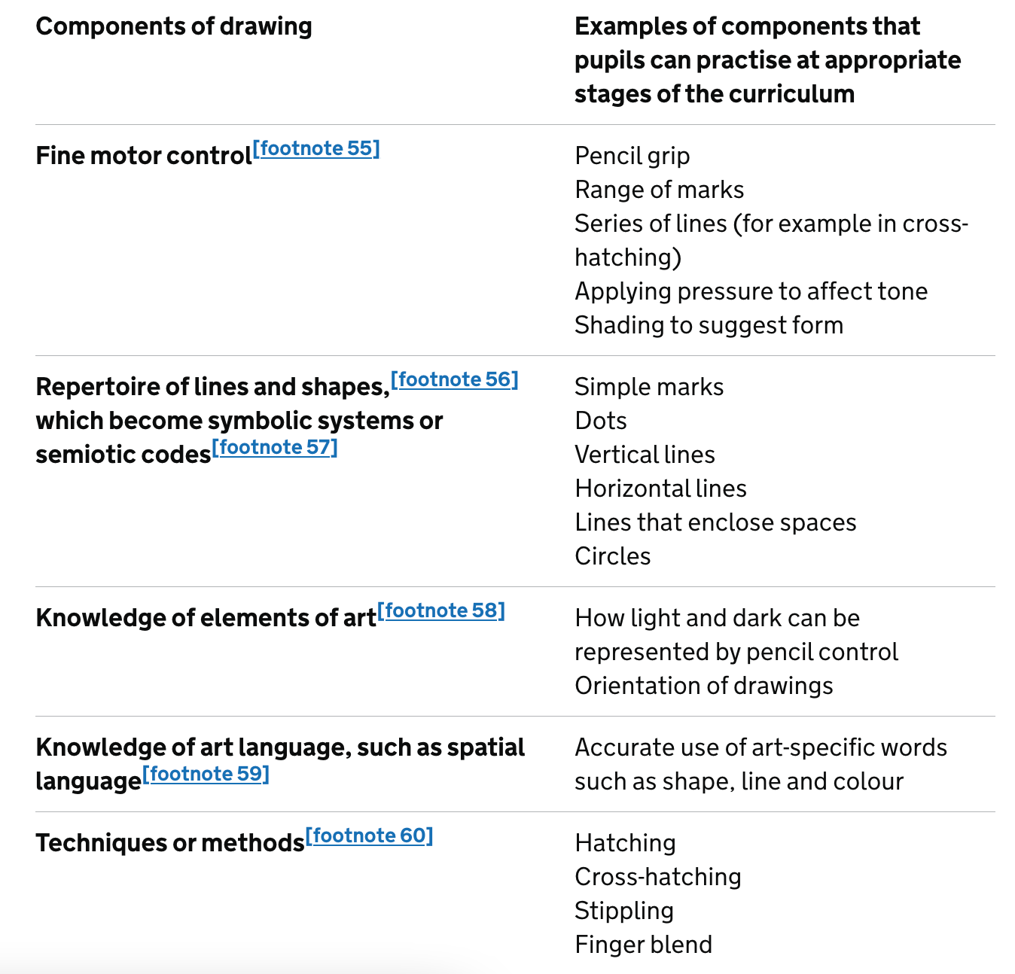
DFE subject review for art and design
DRAWING MUST BE CENTRAL TO THE ART CURRICULUM
Thinking and concentrating
Tuition and Modelling
Recursive Encounters over time
Subject Update
Practical Knowledge
Drawing

Slide 6
DFE subject review for art and design
Outcomes should be:
Subject Update
Curriculum
Convergent
Learn 'about' art
Divergent
Learn 'through' art
e.g) colour theory – children learn that red and yellow make orange
e.g) using colour to convey a mood or personal style

Slide 7
DFE subject review for art and design
Ofsted are placing greater emphasis on knowledge - "connected facts"
Practical Knowledge: "Developing technical proficiency"
Theoretical Knowledge: "The cultural and contextual content that pupils learn about artists and artwork"
Disciplinary Knowledge: "What pupils learn about how art is studied, discussed and judged"
Knowledge needs to be defined in a school's curriculum, but not in a way that restricts or prescribes the artwork produced.
Subject Update
Knowledge
Receptive - Productive
Learning about – Learning to

Slide 8
DFE subject review for art and design
Examples taken from the whole of art history.
For an artist children should know:
About the movement to which they belong
How and why that movement emerged
Influences
Techniques
Themes and meaning of the work
Context – what was happening politically or socially at the time.
Illustrate the variety of established, contested and neglected stories of art
Subject Update
Theoretical Knowledge
Art History

Slide 9
DFE subject review for art and design
How aesthetic judgements are formed and claimed
How art is studied
How to participate in the discourses of artists, scholars and critics
Children need to discuss "big ideas" in art e.g)
‘the value of art cannot be measured by money alone’
‘all art is equal in value’
‘art can never be separated from the artist’
‘artists build on the work of previous artists; artists subvert the work of previous artists’
‘artists create images for the purpose of being seen’
Subject Update
Disciplinary Knowledge
How art is studied

Slide 10
DFE subject review for art and design
PRACTICE
Repetition
Guided instruction
Worked examples
Structured activities
Maquettes, models or sketches
Making links to what has come before
Practicing the same technique with different media
Subject Update
Pedagogy

Slide 11
DFE subject review for art and design
Adaptive Teaching
Support
Challenge
Subject Update
Curriculum
No differentiation
Avoid cognitive overload
Provide examples with identifiable subject matter
Use different method of recording
Quiet spaces
Sensory opportunities
Providing unfinished work to resolve
Provide a personal response with combination of techniques / media
Longer tasks
Task with undetermined end points.

Slide 12
DFE subject review for art and design
Formative
Summative
Including correct vocabulary in written work
Remembering information about artists
Quizzes
Explanatory notes
Sketchbooks
Observations
Assess how a technique has been applied
Whether choices were appropriate
How well meaning has been communicated
Multiple choice questions!
Subject Update
Assessment

